Slide 1
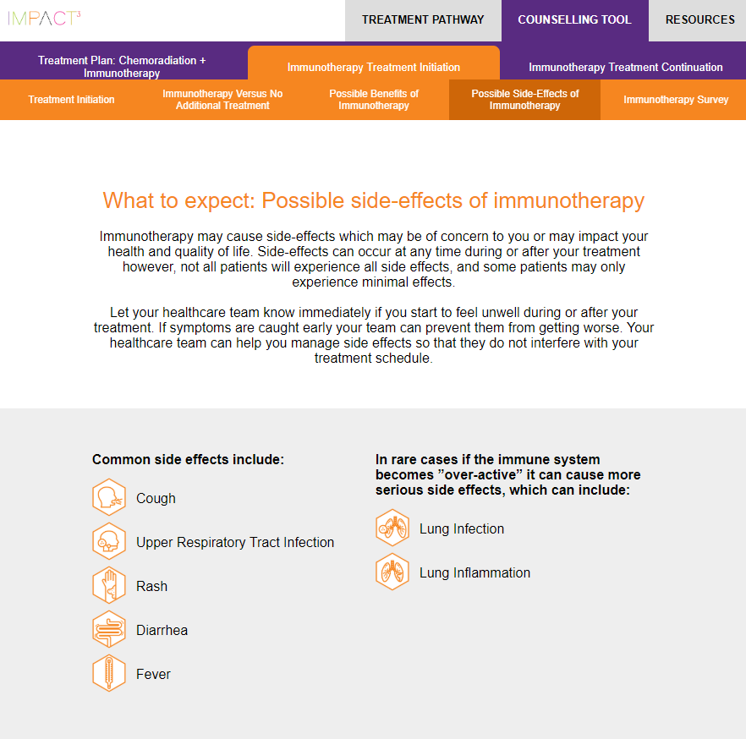
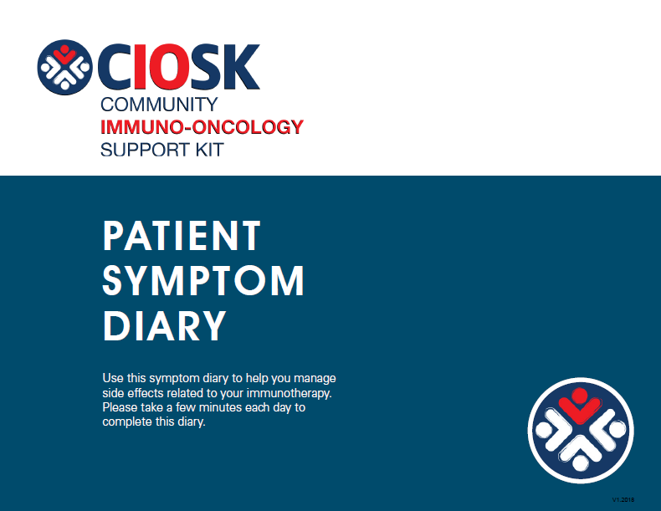

For additional resources on managing side effects, please click on the images below to access the CIOSK Patient Poster Handout on Side Effects or the Patient Symptom Diary.

Slide 2
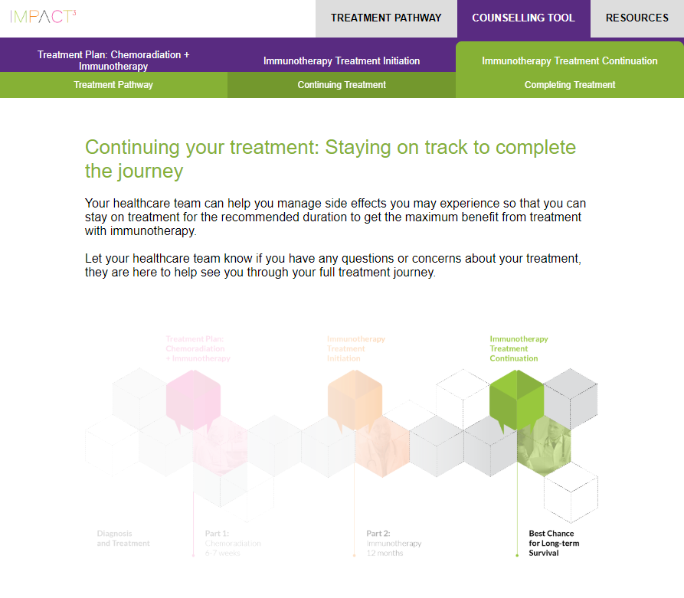

For additional resources on treatment monitoring as you continue your treatment, please click on the image below to access the CIOSK Patient Monitoring Questionnaire.

Slide 3
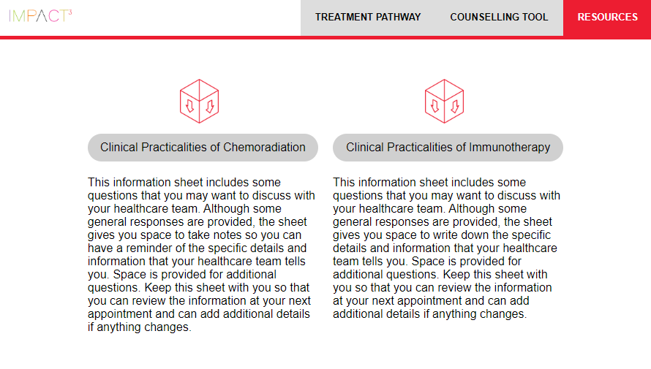
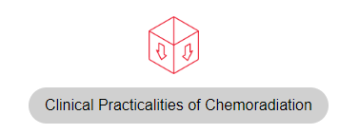
CIOSK Resources
Patient Poster Handout on Side Effects
Patient Monitoring Questionnaire
Overview of side effects of cancer immunotherapy. Includes recommended next steps based on your symptoms.
This checklist includes some questions you may want to discuss with your healthcare team at your follow-up visit to identify signs and symptoms associated with adverse reactions related to immuno-oncology therapy
Patient Symptom Diary
Additional CIOSK Resources
This symptom diary is intended to help you manage side effects related to your immunotherapy. Please take a few minutes each day to complete this diary.
Additional CIOSK resources including patient wallet card, HCP oncology poster, HCP non-oncology poster and HCP immunotherapy letter.

